Slide 1
Fantasy Forecasts
Sprint 2- Baseline Modeling

Slide 2
Non-Technical Overview
Problem Statement
Fantasy sports and sports betting are growing industries where users make decisions based on past player performance to win in fantasy leagues or place strategic bets
By developing predictive models for fantasy points, I can help provide users with data-driven insights that help them make better choices, potentially increasing their success in fantasy leagues and betting outcomes
Opportunity
Fantasy sports players and bettors often struggle to predict player performance accurately, leading to missed opportunities and poor decision-making
Goal
These models aim to improve player performance forecasts, enabling users to make more informed lineup and betting decisions, thus enhancing their overall experience and competitiveness

Slide 3
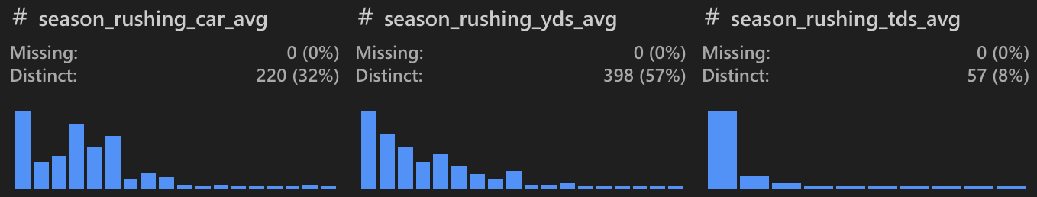
Dataset and Preprocessing Overview
Data
Collected player data for each week of the 2023 NFL season
Divided the data into 4 dataframes, one for each position
Contains various features related to player performance, such as passing/rushing yards, touchdowns, etc.
Preprocessing
Sorted data by PLAYER NAME and DATE for consistent calculations
Removed/created new features to enhance the predictive power of the model
Calculated 5-game rolling averages for key stats to capture recent trends
Computed cumulative season metrics (e.g., season_fantasy_points_avg) for long-term trends
Handled missing values and ensured positional relevance by filtering irrelevant stats

Slide 4
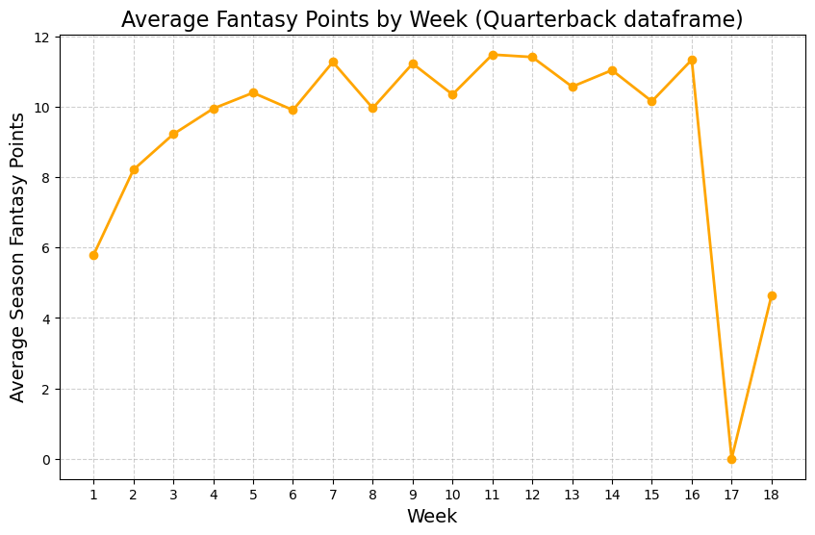
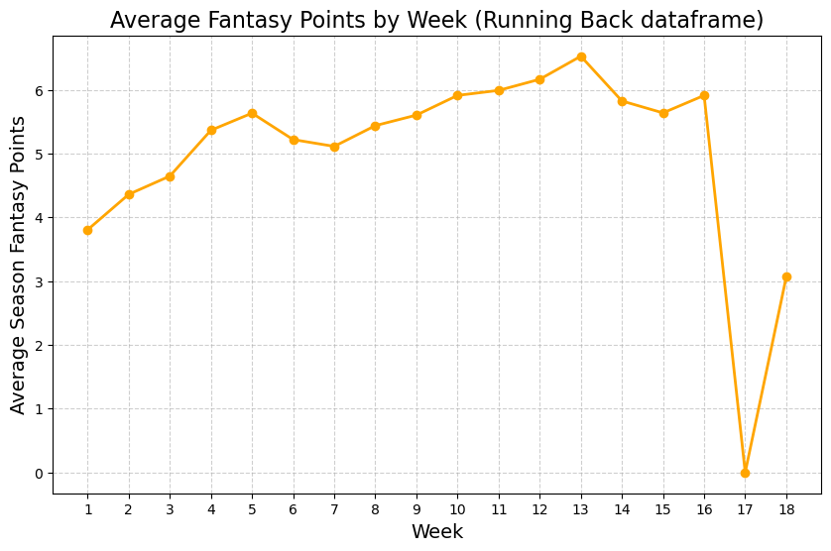
Key Findings from Exploratory Data Analysis
Performance Trends:
On average, each position has a relatively slow start to the season
When plotting the average fantasy points per week, each position showed a gradual increase from around week 1 to 6
Positional Differences:
Quarterbacks have the least consistent stats, which in theory would make them harder to model accurately
Week 17 Issue:
During the EDA process, I encountered an issue related to week 17 statistics for each dataframe
The issue is likely caused by a mistake made in preprocessing
This will be further explored in the subsequent notebook

Slide 5
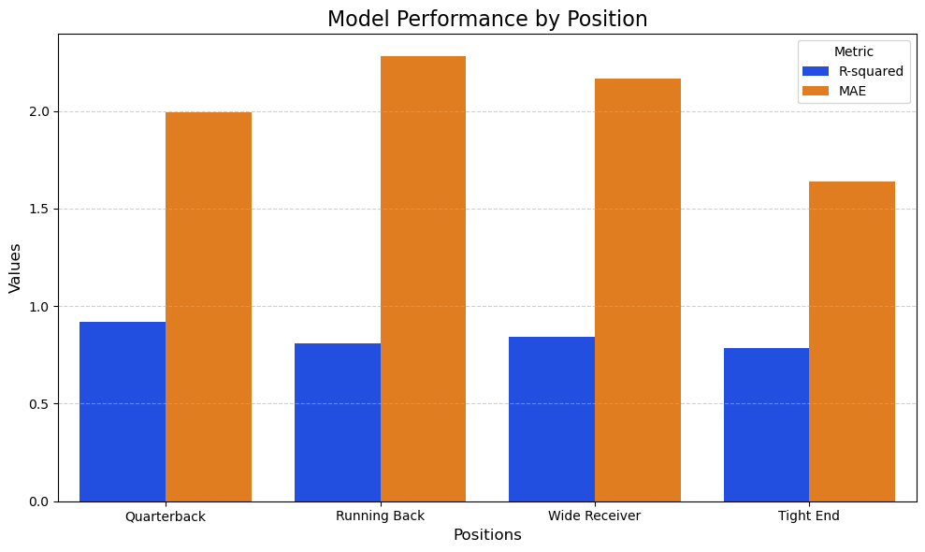
Baseline Models and Evaluation Metrics
Ridge Regression
Introduced regularization to address multicollinearity from overlapping metrics (e.g., season vs. rolling averages)
Performance:
Models performed well
Average R² of ~.83
Average MAE ~2
Models performed much better in regards to MAE when using Grid Search CV
Found that certain positions received better metrics likely due to differences in statistical contributions and variability in performance

Slide 6
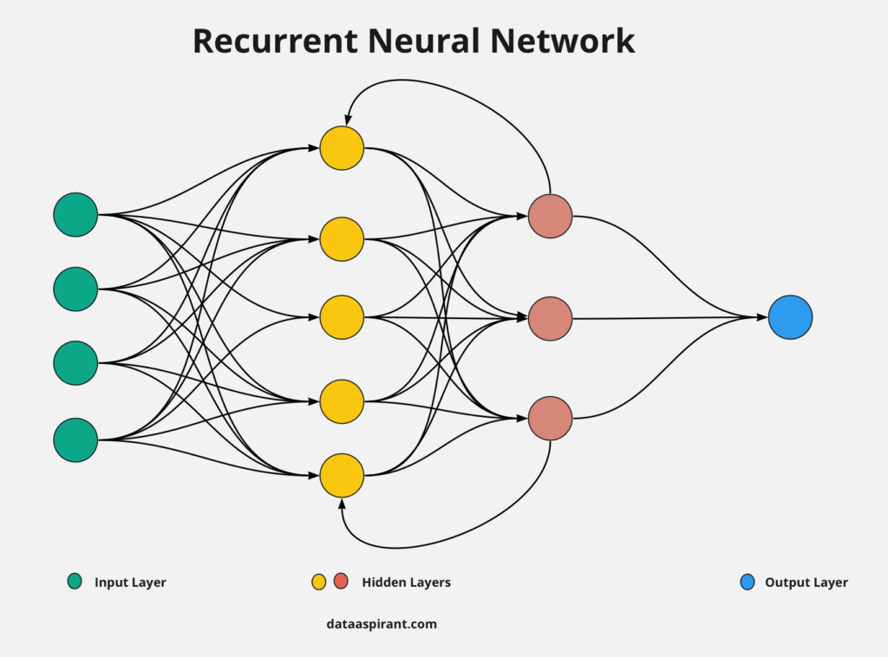
Next Steps
Deal with ‘Week 17’ Issue:
Locate the source of the issue related to Week 17 data and fix it
Advanced Modeling:
Experiment with a Recurrent Neural Networks
Implement Random Forest ensemble models
Feature Engineering:
Potentially incorporate contextual features:
Game-specific factors (e.g., opponent strength)
Weather conditions and playoff implications
Productization:
Develop a user-friendly program for fantasy managers to access predictions

